Slide 1

Transportation and Management System
Team No Chance
Mymona Afjen Syma
ID:191-15-12778
Daffodil International University

Slide 2
Motivation
Passengers do not have the facility to book their tickets before getting on the bus. As a
result, they do not know the bus has seats or not.
01
Some buses go with standing passengers, and some go with accessible seats.
02
Buses routes and location is not update in time . For this can’t know the exact location of buses.
03

Slide 3
Objective
Handling the total management system. For example, the admin can add the bus route, bus list, manage users, manage booking confirmations, generate a regular report, and add more solving issue. To see the route plan before ticketing. Buying e-ticket and book buses .Getting the live location of the bus with a GPS tracker.

Slide 4
Methodology of the work
Want to make a web application which will be the solution of transportation problem of DIU. Where will make a user interface for user which they will be able to use. And also for admin panel there be a major part for maintenance . Here will use a framework to make user interface . For the backend will use a language which make the solution responsive and efficient.

Slide 5
Features
Seat booking and availability checking.
Payment process.
Tracking location of buses.
To view the available routs of bus.
Customer management process.

Slide 6
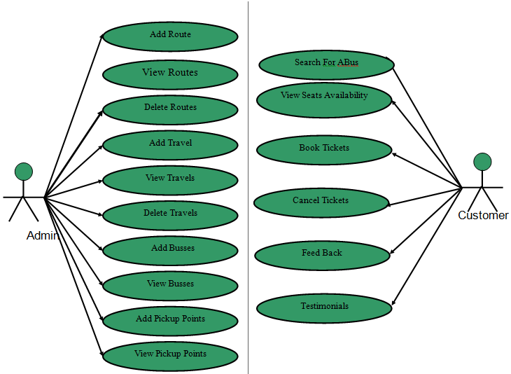

Slide 7
Final Output
In the final view will be able to see all the mentioned problems solution in the prepared application. Where will be able to make the transportation system in automation system. There be the smart approach for the payment system where all students and faculties provide a card and payment will discharge from the card. Able to track the bus’s location from any where and time. Finally will be able to make a automation transport system to make more easy for transportation.

Slide 8
Thank You

